Slide 1
IMAGE SCENE CLASSIFICATION USING CONVOLUTIONAL NEURAL NETWORK
Name: Oluwatosin Adeoye
Student Number: 202249324

Slide 2
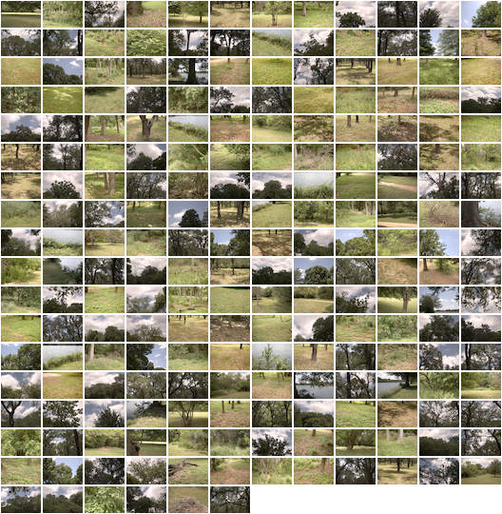
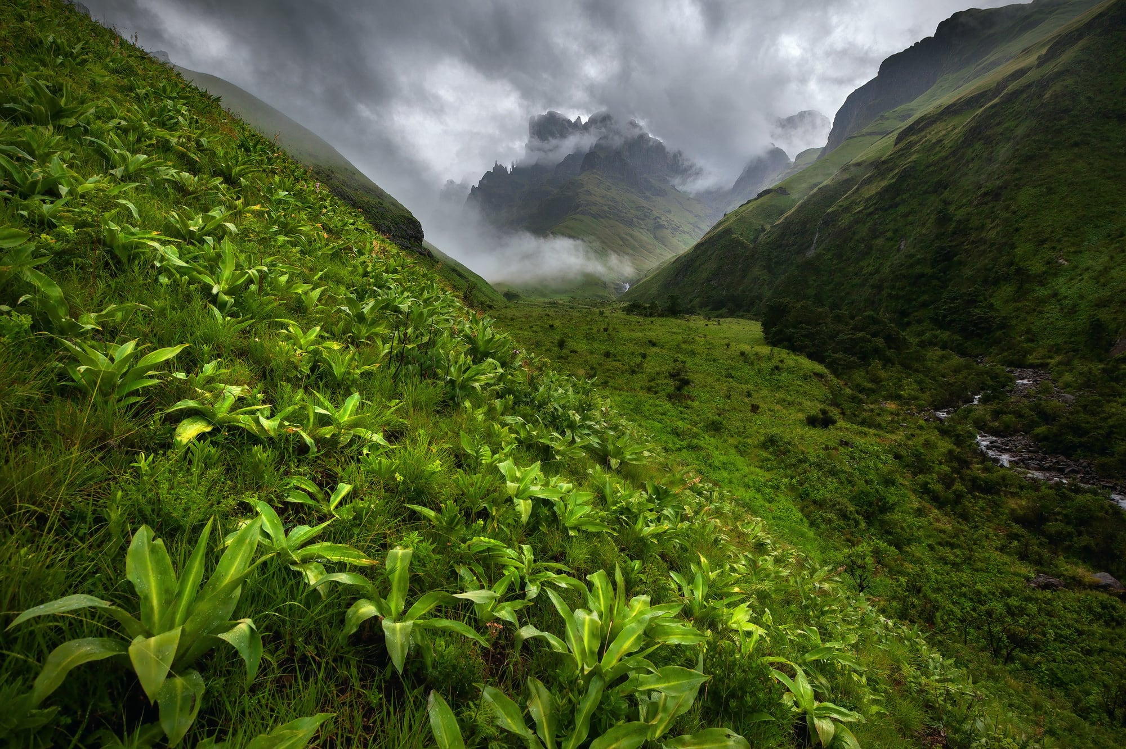
Project analysis slide 3
Introduction
Image recognition and Scene Classification are keystone tasks in computer vision. Scene classification plays a crucial role in various applications, including autonomous driving, content analysis, and surveillance. Scientists leverage the objects present in a scene to develop a deeper understanding of its structure. They believe that advancements and studies in image comprehension will have a direct influence on image classification research since the two tasks are interconnected.(Soudy et al., 2022)

Slide 3
Project analysis slide 3
Related Works
Chen, L., Li, S., Bai, Q., Yang, J., Jiang, S. & Miao, Y. (2021) Review of Image Classification Algorithms Based on Convolutional Neural Networks. Remote Sensing, 13(22), 4712. Available online: https://doi.org/10.3390/rs13224712.
Used Model: Convolutional Neural Network(CNN), ResNet 50, ResNet 101, AlexNet, InceptionV1
Cheng, G., Han, J. & Lu, X. (2017) Remote Sensing Image Scene Classification: Benchmark and State of the Art. Proceedings of the IEEE, 105(10), 1865–1883. Available online: https://doi.org/10.1109/JPROC.2017.2675998.
Used Model: AlexNet, VGGNet-16, and GoogLeNet
Soudy, M., Afify, Y. & Badr, N. (2022) RepConv: A novel architecture for image scene classification on Intel scenes dataset. International Journal of Intelligent Computing and Information Sciences, 0(0), 1–11. Available online: https://doi.org/10.21608/ijicis.2022.118834.1163.
Used Model: Convolutional Neural Network(CNN), ResNet 50, ResNet 101

Slide 4
Project analysis slide 3
Aims and Objectives
Aim
The aim of this project is to develop an efficient and accurate image scene classification model using Convolutional Neural Networks (CNN).
Objectives
Achieve high accuracy in image scene classification and gain insights into the effectiveness of the custom-designed CNN architecture for scene classification.
Perform a performance comparison with pretrained models, such as VGGNet, ResNet and Inception, to assess the competitiveness of the proposed model and utilize pretrained models as baselines for performance evaluation.

Slide 5
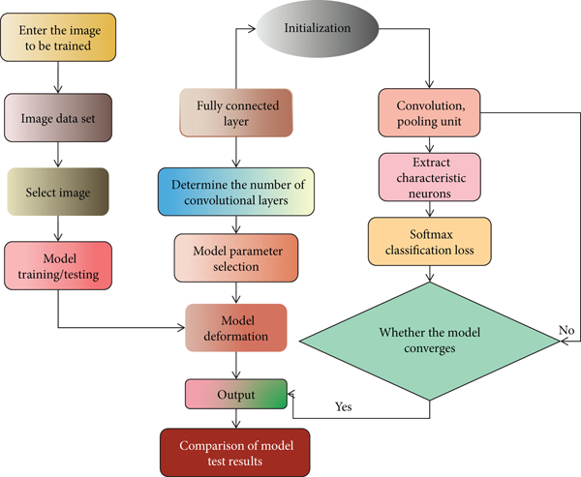
Project analysis slide 3
Research Methodology
Dataset selection (Intel Image Dataset from Kaggle.com)
Data Preprocessing
CNN model architecture design
Model training and evaluation
Comparison with pretrained models: (VGGNet, ResNet, and Inception)
Fine-tuning and optimization
Lingyan, 2022

Slide 6
Thank You

